Slide 1
Computerized Adaptive Test System
Submitted by : Md. Khairul Alam
Roll : BSSE1118
Supervisor : Prof. Dr. Zerina Begum

Slide 2


What is a CAT?
Is it me?
Reference : https://www.vectorstock.com/royalty-free-vector/creative-black-cute-cat-logo-vector-22551312

Slide 3
Definition of CAT
One kind of Computer Administered Test
Adapts to the examinee’s ability
3. Every time next item is selected by examinee’s responses
Objectives of CAT
Provide more accurate measurement
Higher engagement of students
3. Remove depression of students
CAT is used in Graduate Management Admission Test in US , Public Accountant Examination

Slide 4
Advantages of CAT
CAT avoids administering irrelevant questions.
CAT tests can be shorter.
CAT tests can be quicker to develop, implement and report.
CAT tests can be better experiences.

Slide 5
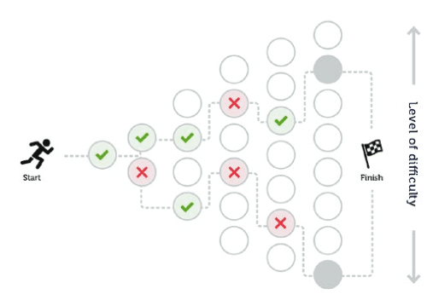
Visualization of CAT
Reference : https://apasseducation.com/education-blog/two-types-computer-adaptive-testing-assessment/

Slide 6
Motive of the Project
As I love logical things , I want to build a computer based test
So, I found computerized adaptive test system as my project
It helps me to learn CAT more precisely
And I found test system as a interesting thing.

Slide 7
Implementing Project
Making question sets according to the difficulty level(easy , medium , hard ).
2. In each set of questions , questions are randomly generated.
3. User give their choice and get a response.
Question generating using Rasch Algorithm and Monte Carlo Algorithm
Showing the Performance or Grade
Github link of the project : https://github.com/meKhairul/SPL---1

Slide 8
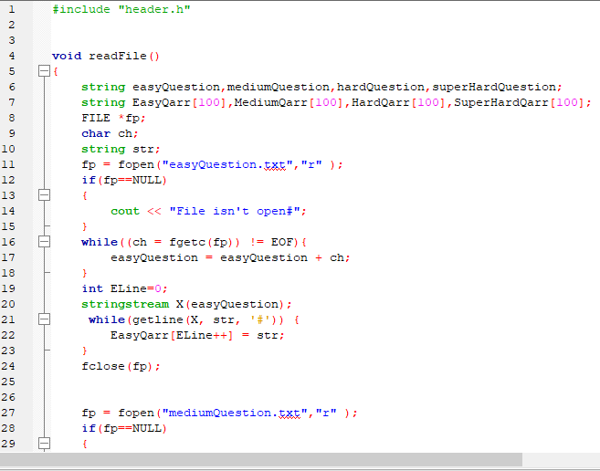
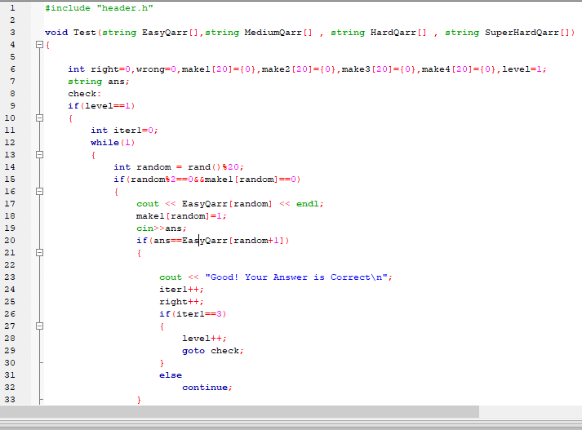
Reading Files
Test System

Slide 9
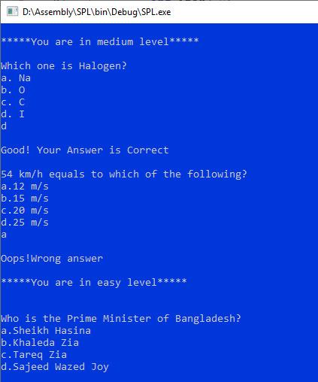
Output

Slide 10
References
https://en.wikipedia.org/wiki/Computerized_adaptive_testing
https://www.rasch.org/rmt/rmt213d.htm
https://en.wikipedia.org/wiki/Monte_Carlo_method

Slide 11


Slide 12


Slide 13
Inroduction of the Project
1. The program will consist some specific set of questions on one topic or various topics.
2. By evaluating students ability , question set will be changed.
3. The project will be implemented using Rasch Algorithm and Monte Carlo Algorithm.
Finally , the grade/performance of the user will be displayed.

